Slide 1



AUTOCORRECT ON ARABIC

Slide 2
OVERVIEW
Goal: Build an Arabic spell-checker that detects and corrects misspellings using a Masked Language Model (MLM).
Approach: Fine-tuned MARBERT (transformers-based model) to understand Arabic context and correct words using top-k predictions.
Use Case: Arabic news, educational texts, or social content where high-quality language is required.

Slide 3
ABSTRACT
This project enhances Arabic spelling correction by leveraging a fine-tuned MARBERT-based Masked Language Model (MLM) to intelligently detect and correct misspellings using context-aware predictions.
By addressing both common and complex errors in Arabic texts, the system significantly improves preprocessing quality and boosts the overall performance of downstream NLP applications.

Slide 4
INTRODUCTION
Spelling mistakes in Arabic texts pose a serious challenge to NLP systems, and this project addresses the issue through a context-aware correction approach using a fine-tuned MARBERT MLM, aiming to improve preprocessing quality and correction accuracy.

Slide 5
Dataset Details
Source: arabic_dataset_classifiction.csv (custom-labeled news articles)
Size: 111,728 rows originally
Preprocessing:
Normalized Arabic characters (أ → ا, etc.)
Removed punctuation and short/duplicate sentences
Final cleaned data used: ~10,000 sentences
Train/Test Split: 80% training / 20% testing

Slide 6
Model Details
Base Model: UBC-NLP/MARBERT (Masked Language Model trained on Arabic)
Fine-Tuning:
MLM objective with 15% token masking
Training for 10 epochs on cleaned dataset
Used Trainer API from Hugging Face

Slide 7
Training Parameters
Parameter | Value
Epochs | 10
Learning Rate | 3e-5
Batch Size (Train/Eval) | 16
Gradient Accumulation | 4
Mixed Precision (FP16) | Enabled
Optimizer | Adafactor

Slide 8
Training Performance
Epoch | Training Loss | Validation Loss
1 | 3.52 | 3.14
5 | 2.76 | 2.83
10 | 2.50 | 2.73
The model is improving over time – indicating successful learning.

Slide 9
Pipeline Process
Preprocess Input Text: Clean and normalize Arabic
Build Vocabulary: Extract high-frequency words
Find Misspellings: Use MLM probabilities to detect low-likelihood words
Mask and Predict: Replace suspected word with [MASK] and predict top-k replacements
Correct Word: Choose closest valid replacement using Levenshtein distance

Slide 10
Example Corrections
Incorrect:
"وززارة النربية والتعليم تعلن عن تعطبل الدراسة"
Corrected:
"وزارة التربية والتعليم تعلن عن تعطيل الدراسة"
Other Examples:
"الريس" ➝ "الرئيس"
"المعلمون و الططلاب" ➝ "المعلمون والطلاب"

Slide 11
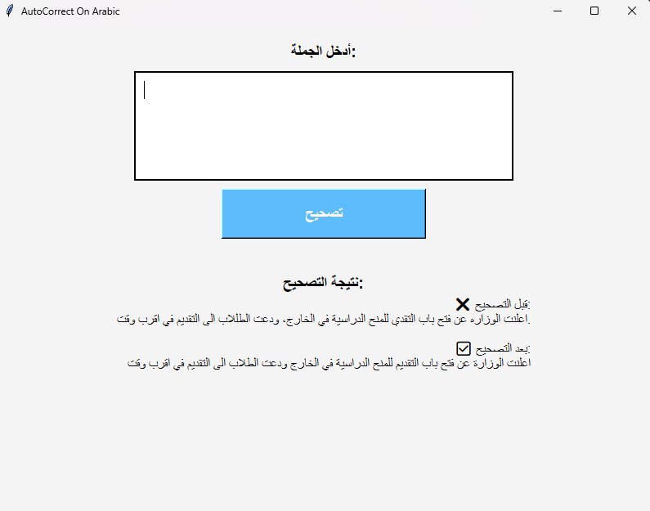
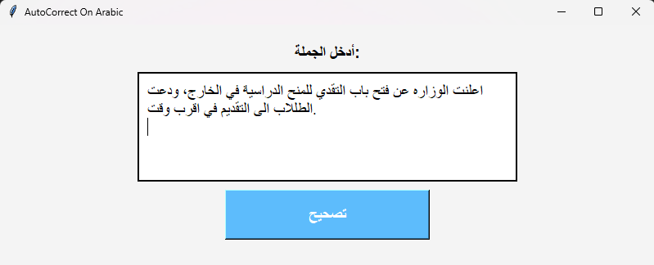
GUI
Input
Output

Slide 12
LIMITATIONS
Vocabulary quality highly depends on the dataset – OOV (out-of-vocabulary) words may be missed.
Model may not understand sarcasm, slang, or dialectal variations.
Requires GPU for real-time correction (slow on CPU).
Tokenization issues: some Arabic words may be split inappropriately.
Sometimes the meaning of the word changes.

Slide 13
FUTURE WORK
Use larger and more diverse Arabic corpora (e.g., social media, books).
Add part-of-speech constraints to reduce overcorrection.
Extend to grammar correction, not just spelling.
Deploy as a web or mobile API.

Slide 14
CONCLUSION
Successfully trained a spelling correction model for Arabic using MARBERT.
Showed measurable improvement in language modeling loss.
Real-world cases confirm effective correction of various spelling errors.
Levenshtein distance improves correction by prioritizing similar words.

Slide 15
Thank You
For your attention

